Slide 1

Forest & Range
Evaluation Program
DNI CC
Forest Management
Leadership Team Discussion
September 23, 2021
Notes:
Diane or Jim lead in:
Diane, Jim, Ian and Peter
Topic: We are here to explain what FREP is and the benefits to the MFR and broader natural resource sector
Format: 15 minutes of presentation, followed by 15 minutes of questions and discussion
Specifically:
What FREP is
The purpose/goal of FREP
Why we need FREP
How FREP works
How FREP instigates change, and
Moving forward

Slide 2
Outline
What’s New in FREP
- new or improved protocols
- First Nations engagement & partnerships
- Licensee reporting & engagement
FREP Dashboard
– DNI results to 2020
- 2021 sampling results - Paul Barolet
Riparian evaluation– Lisa Nordin
- DNI and Coast sampling results
- Riparian re-assessment findings

Slide 3
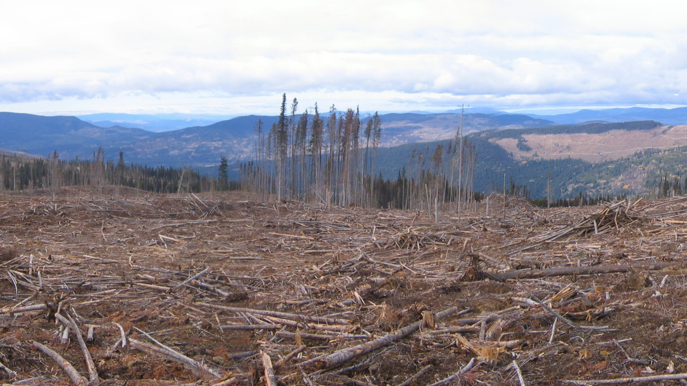
What’s New -Monitoring Protocols
Stand Level Retention – updated
  New landscape context indicators
  New rating system –
  -8 Y/N questions based on 20 indicators, benchmarks related to research & guidance
Routine Watershed Assessment - new
  new ‘routine’ level protocol for assessing riparian condition at a watershed level
  combines riparian, water quality and fish passage sampling with GIS assessment of riparian disturbance
Wildlife Designated Areas assessment - new
  Phase 1 GIS assessment of disturbances (UWR/WHA)
  Phase 2 detailed assessments of habitat condition & use in selected areas

Slide 4
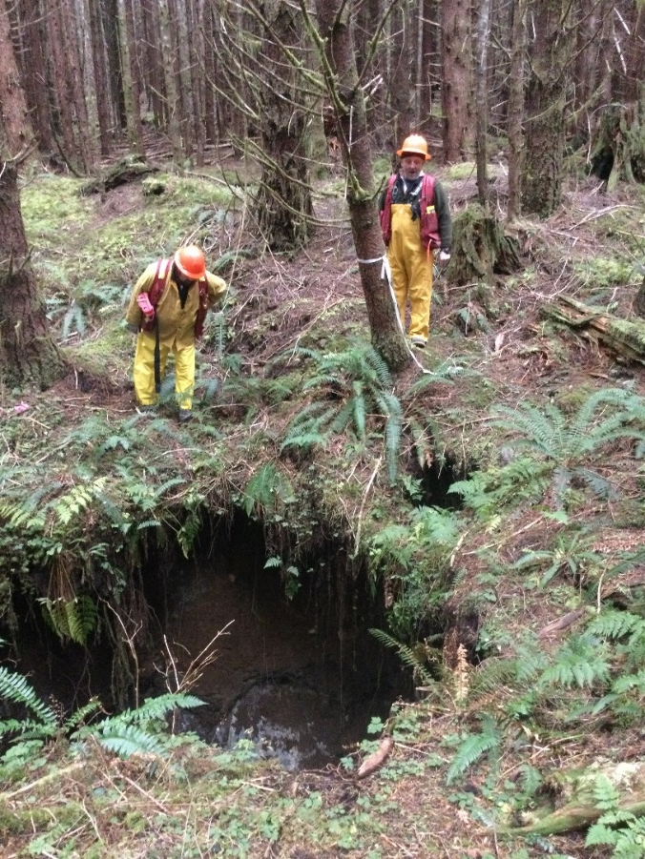
What’s New – Karst Protocol
Evaluation Question
“Are current forest practices protecting and conserving surface karst features and high vulnerability karst terrain?”
Indicators: tree removal, windthrow, deposition of slash/road materials, impacts to soil/bedrock, burning, shade alteration, plant community alteration
MRVA rating – under development
2021 pilot sampling – 15 planned for VI
Licensee Webinar – Oct.
- protocol overview & input on draft ratings

Slide 5
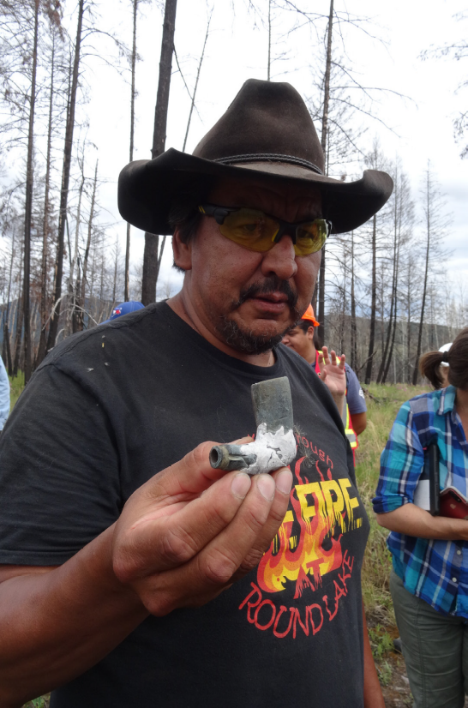
First Nations Engagement & Partnerships
30 indigenous communities engaging in FREP sampling & training in 2021
  Increasing role for Guardians
Collaborative CHR protocol development Secwepemc Nation
(17 communities)
Collaborative watershed assessment – 3 northern Secwepemc communities

Slide 6
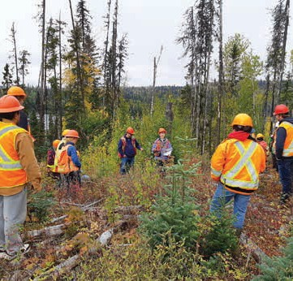
Licensee engagement & reporting
Sampling & Training
- Licensee engagement in FREP training & sampling
- Riparian overview for licensees (Nov)
Reporting:
- annual reporting of results by email
- licensee riparian reports
- FREP Dashboard
- MRVA’s (online)
Extension:
- ABCFP Professional Magazine – FREP Spotlight on Effective Riparian Practices, Water quality (in progress)
- FREP Reports - 10 year summary of Water Quality Results, Kootenay Watershed Assessment Pilot

Slide 7
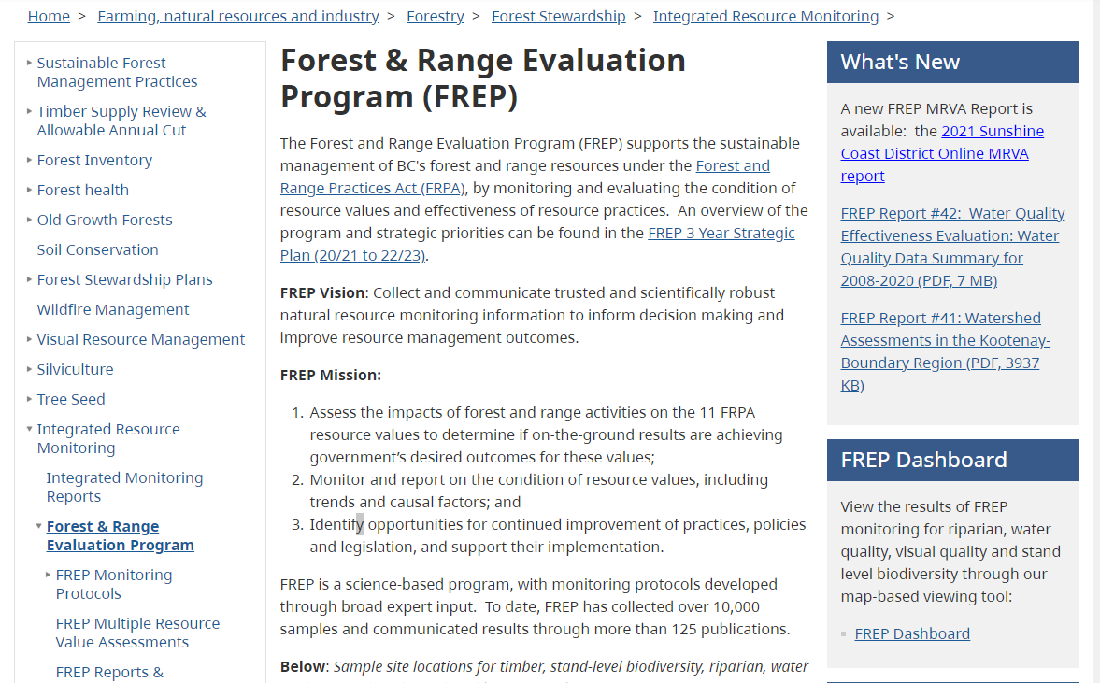
FREP Reporting

Slide 8
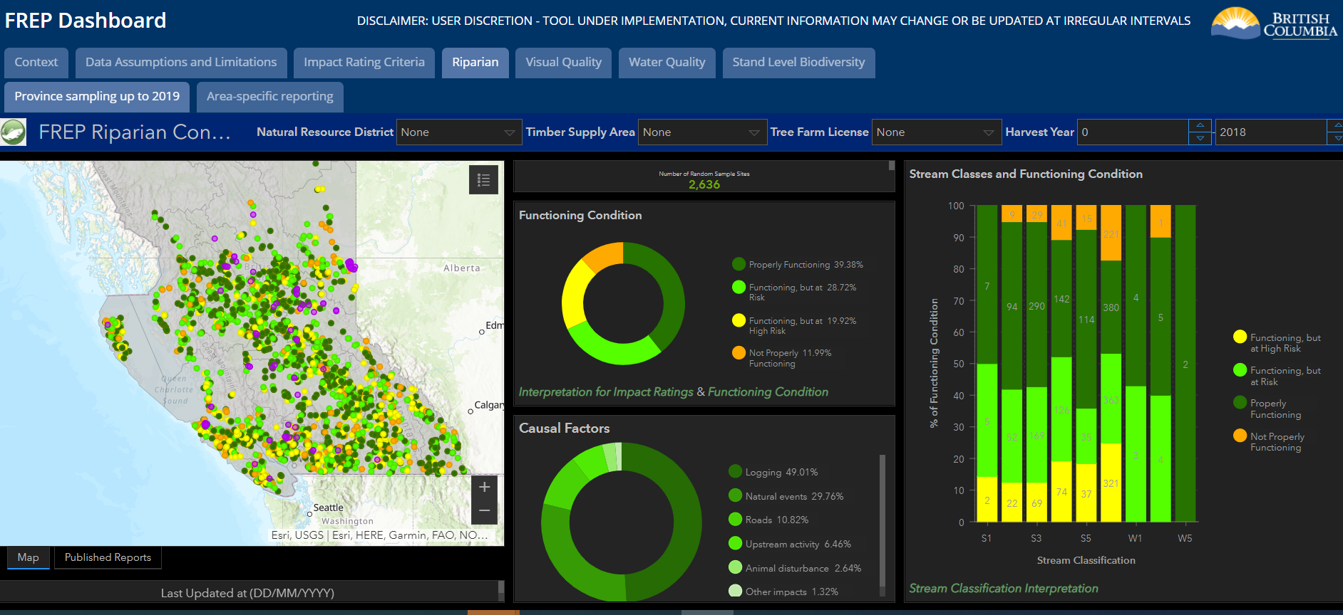
FREP Dashboard – Find monitoring results
FREP Website (or Google FREP dashboard)
https://www2.gov.bc.ca/gov/content/industry/forestry/managing-our-forest-resources/integrated-resource-monitoring/forest-range-evaluation-program

Slide 9
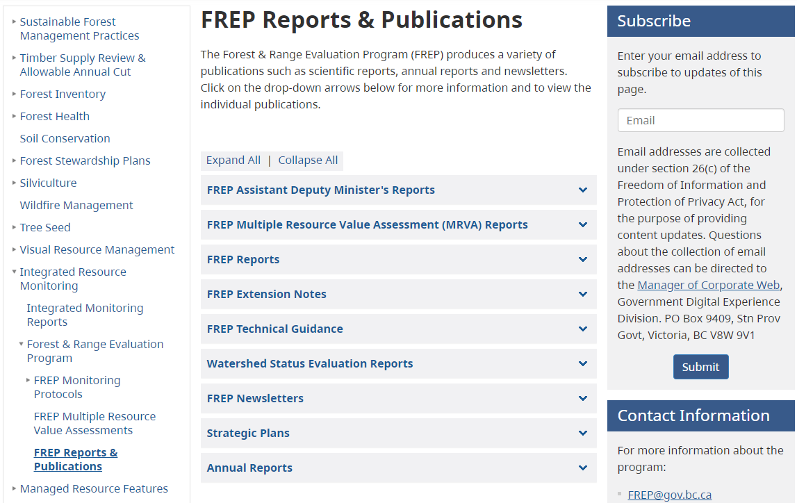
FREP Reports – Subscribe for Notifications

